Slide 1
University of agricultural sciences,banglore-560065 College of Agriculture, GKVK EAI-421: AI & ML in Agriculture (0+10)
PROJECT TITLE – MACHINE LEARNING BASED GROUNDWATER QUALITY ANALYSIS
ID NO-AMB2016
AMB2103
AMB2177

Slide 2
Content
•Introduction
•Problem Statement
•Motivation
•Objectives of the project
•Dataset Overview
•Methodology/approach
•Tools and Technologies Used
•Results
•Discussion / Analysis
•Conclusion and Future Work
•References/Acknowledgements

Slide 3
INTRODUCTION
Groundwater is a critical resource for drinking, irrigation, and industrial applications, but its quality is increasingly impacted by natural processes and human activities.
Timely and accurate assessment of groundwater quality is essential for sustainable management.
This capstone project presents the development of an Artificial Intelligence (AI) and Machine Learning (ML)-based system to analyze and predict groundwater quality using real-world datasets, enhancing the efficiency of traditional evaluation methods.

Slide 4
PROBLEM STATEMENT
- Groundwater quality assessment is crucial for safe drinking water and agriculture.
- Traditional methods are time-consuming, costly, and lack real-time insights.
- 2018 data shows variations in pH, EC, TDS, hardness, indicating health and productivity risks.
- Need for efficient, accurate, and scalable AI-driven system to predict water quality.
Project Goal
- Develop ML model to classify groundwater as safe/unsafe, improving prediction accuracy and decision-making.

Slide 5
MOTIVATION
Importance
- Ensures safe drinking water (health risks: fluoride, arsenic, nitrate)
- Protects agriculture productivity & soil health
- Addresses India's water scarcity & stress
Practical Applications
- Precision irrigation & crop selection
- Early contamination alerts for farmers
- Informed policy & remediation efforts
Relevance
- Supports Clean Water
- water management, agri-tech, risk assessment

Slide 6
OBJECTIVES
01. To analyze the 2018 post-monsoon groundwater quality dataset and understand variations in key physicochemical parameters such as pH, EC, TDS, and hardness.
02. To develop and apply machine learning models (Random Forest, Decision Tree, etc.) for predicting and classifying groundwater quality.
03. To evaluate and compare model performance to identify the most accurate approach for groundwater quality prediction.

Slide 7
DATASET OVERVIEW
Dataset source: Ground water quality 2018 post monsoon data from kaggle
Number of records and features: 300 samples, 9 features (pH, EC, TDS, Hardness, Alkalinity, Chloride, Sulphate, Nitrate, Fluoride)
Types of features: Numerical (physicochemical parameters)
- Preprocessing steps: Data loading, feature selection, normalization, train-test split

Slide 8
Feature | Type | Source
pH | Numerical (Continuous) | Field measurement
Electrical Conductivity | Numerical (Continuous) | Field measurement
Total dissolved solids | Numerical (Continuous) | Field measurement
Total hardness | Numerical (Continuous) | Field measurement
Alkalinity | Numerical (Continuous) | Field measurement
Chloride | Numerical (Continuous) | Laboratory analysis
Sulphate | Numerical(Continuous) | Laboratory analysis
Nitrate | Numerical (Continuous) | Laboratory analysis
Fluoride | Numerical (Continuous) | Laboratory analysis
Groundwater Quality Index | Numerical (Target) | Computed/Derived

Slide 9
APPROACH
• Data Preprocessing
Upload CSV/Excel dataset in Google Colab
Feature selection (pH, EC, TDS, etc.)
Normalize data using MinMaxScaler
Train-test split (80:20)
• Exploratory Data Analysis
Water quality distribution
Correlation heatmap
Identify key influencing parameters
• Model Selection
Random Forest
Decision Tree
Logistic Regression
• Model Training & Validation
Train models on training data
Test on unseen data
Select best-performing model
• Evaluation Metrics
Accuracy
F1-score
Confusion Matrix

Slide 10
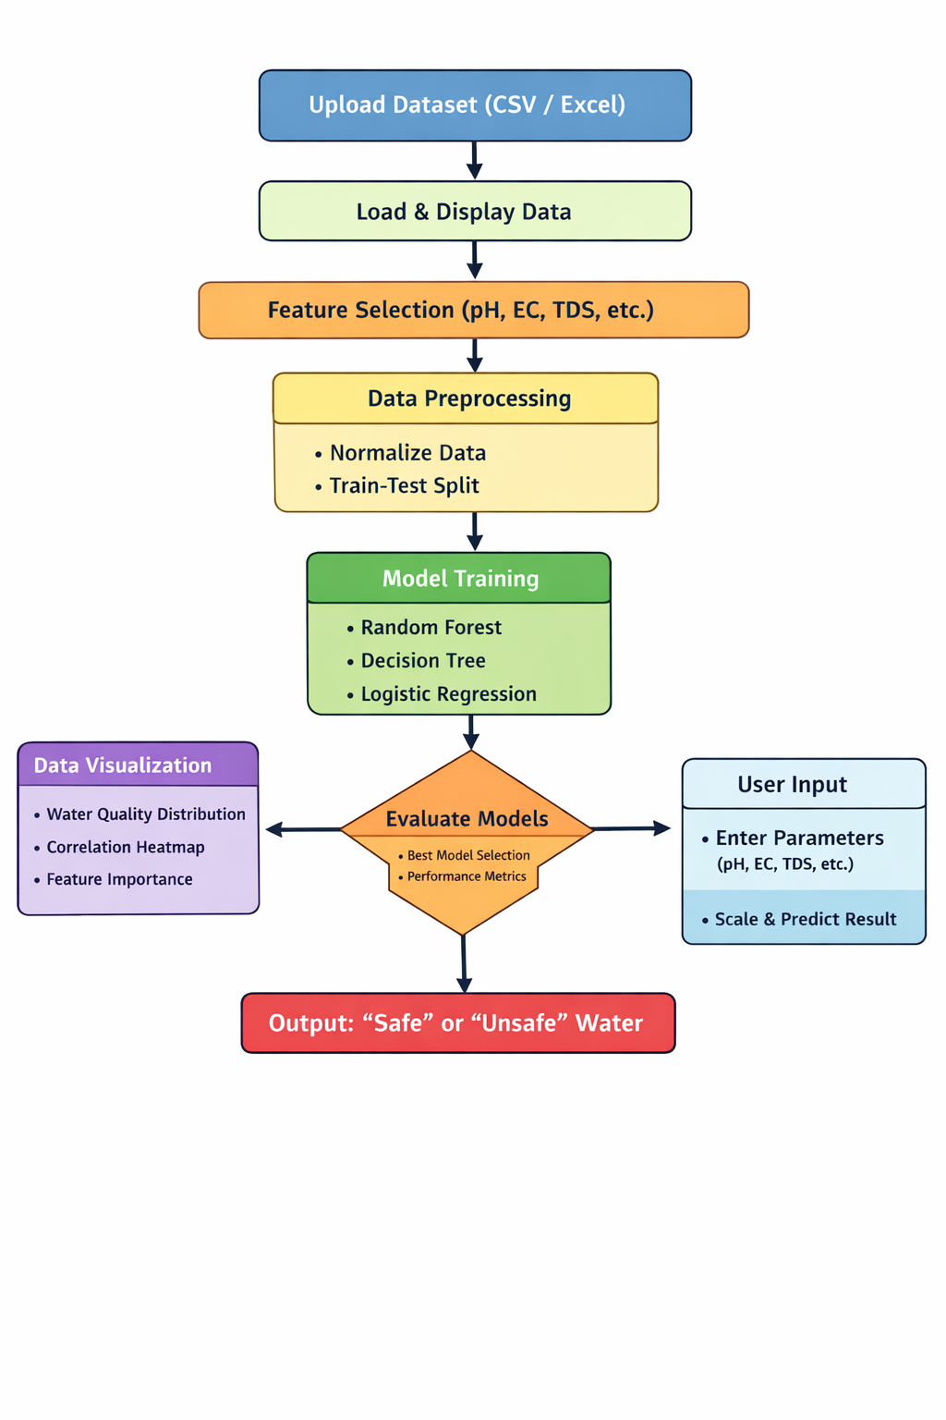

Slide 11
Tool / Technology | Role in the Project
Python 3.x | Core programming language used to implement the entire ML pipeline
pandas | Used for data loading, manipulation, and preprocessing of dataset
NumPy | Performs numerical computations and array operations
matplotlib | Used for data visualization like bar charts and heatmaps
scikit-learn | Machine learning library used for model building and evaluation
Random Forest Classifier | Ensemble algorithm that improves accuracy using multiple decision trees
Decision Tree Classifier | Tree-based model that classifies data using decision rules
Logistic Regression | Statistical model used for binary classification (Safe/Unsafe)
train_test_split | Splits dataset into training and testing sets
Confusion Matrix | Evaluates classification performance by comparing actual vs predicted values

Slide 12
PYTHON CODE
# --- 1. Upload File in Colab ---
from google.colab import files
uploaded = files.upload()
# Get uploaded file name
file_name = list(uploaded.keys())[0]
# --- 2. Import Libraries ---
import numpy as np
import pandas as pd
import matplotlib.pyplot as plt
from sklearn.ensemble import RandomForestClassifier
from sklearn.tree import DecisionTreeClassifier
from sklearn.linear_model import LogisticRegression
from sklearn.preprocessing import MinMaxScaler
from sklearn.model_selection import train_test_split
from sklearn.metrics import accuracy_score, confusion_matrix, classification_report

Slide 13
# --- 7. Model Training ---
models = {
"Random Forest": RandomForestClassifier(),
"Decision Tree": DecisionTreeClassifier(),
"Logistic Regression": LogisticRegression()
}
results = {}
for name, model in models.items():
model.fit(X_train, y_train)
y_pred = model.predict(X_test)
acc = accuracy_score(y_test, y_pred)
results[name] = acc
print(f"\n{name} Results:")
print("Accuracy:", acc)
print("Confusion Matrix:\n", confusion_matrix(y_test, y_pred))
print("Classification Report:\n", classification_report(y_test, y_pred))
# --- 8. Best Model ---
best_model = max(results, key=results.get)
print("\nBest Model:", best_model)
import warnings
warnings.filterwarnings('ignore')
# --- 3. Load Dataset ---
if file_name.endswith('.csv'):
df = pd.read_csv(file_name)
else:
df = pd.read_excel(file_name)
print("Dataset Loaded:\n", df.head())
# --- 4. Feature Selection ---
features = ['pH', 'EC', 'TDS', 'Alkalinity', 'Hardness', 'Cl', 'F', 'NO3', 'SO4']
X = df[features]
y = df['Water_Quality']
# --- 5. Preprocessing ---
scaler = MinMaxScaler()
X_scaled = scaler.fit_transform(X)
# --- 6. Train-Test Split ---
X_train, X_test, y_train, y_test = train_test_split(
X_scaled, y, test_size=0.2, random_state=42
)

Slide 14
# --- 9. Visualization ---
# 1. Water Quality Distribution
plt.figure()
df['Water_Quality'].value_counts().plot(kind='bar')
plt.title("Water Quality Distribution")
plt.show()
# 2. Correlation Heatmap
plt.figure()
corr = df.corr()
plt.imshow(corr)
plt.colorbar()
plt.xticks(range(len(corr.columns)), corr.columns, rotation=90)
plt.yticks(range(len(corr.columns)), corr.columns)
plt.title("Correlation Heatmap")
plt.show()
# 3. Feature Importance
best = models[best_model]
importances = best.feature_importances_
plt.figure()
plt.bar(features, importances)
plt.xticks(rotation=45)
plt.title("Feature Importance (" + best_model + ")")
plt.show()
# --- 10. User Input for Prediction ---
print("\nEnter Water Quality Parameters:")
ph = float(input("pH: "))
ec = float(input("EC: "))
tds = float(input("TDS: "))
alk = float(input("Alkalinity: "))
hard = float(input("Hardness: "))
cl = float(input("Cl: "))
f = float(input("F: "))
no3 = float(input("NO3: "))
so4 = float(input("SO4: "))
sample = [[ph, ec, tds, alk, hard, cl, f, no3, so4]]
sample_scaled = scaler.transform(sample)
prediction = models[best_model].predict(sample_scaled)
print("\nPrediction:",
"Safe Water" if prediction[0] == 1 else "Unsafe Water")

Slide 15
OUTPUT
Random Forest Results:
Accuracy: 0.95
Confusion Matrix:
[[57 0]
[ 3 0]]
Classification Report:
precision recall f1-score support
0 0.95 1.00 0.97 57
1 0.00 0.00 0.00 3
accuracy 0.95 60
macro avg 0.47 0.50 0.49 60
weighted avg 0.90 0.95 0.93 60
Decision Tree Results:
Accuracy: 0.9666666666666667
Confusion Matrix:
[[57 0]
[ 2 1]]
Classification Report:
precision recall f1-score support
0 0.97 1.00 0.98 57
1 1.00 0.33 0.50 3
accuracy 0.97 60
macro avg 0.98 0.67 0.74 60
weighted avg 0.97 0.97 0.96 60
Logistic Regression Results:
Accuracy: 0.95
Confusion Matrix:
[[57 0]
[ 3 0]]
Classification Report:
precision recall f1-score support
0 0.95 1.00 0.97 57
1 0.00 0.00 0.00 3
accuracy 0.95 60
macro avg 0.47 0.50 0.49 60
weighted avg 0.90 0.95 0.93 60
Best Model: Decision Tree

Slide 16
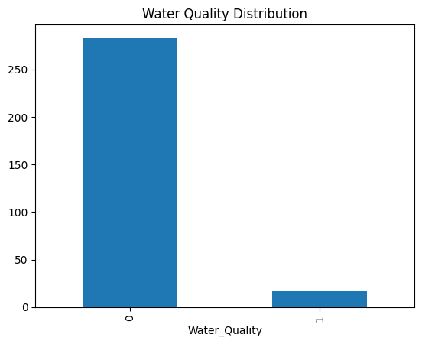
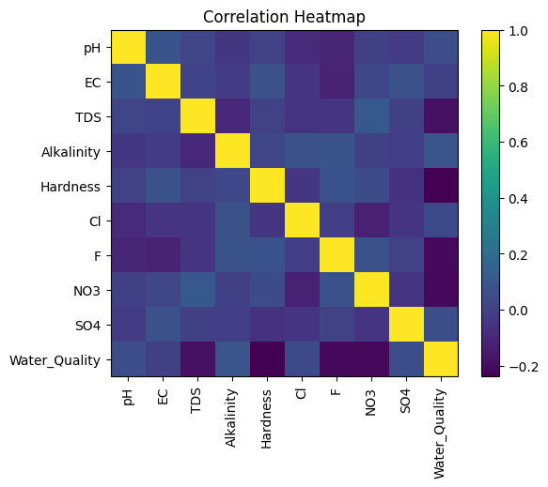
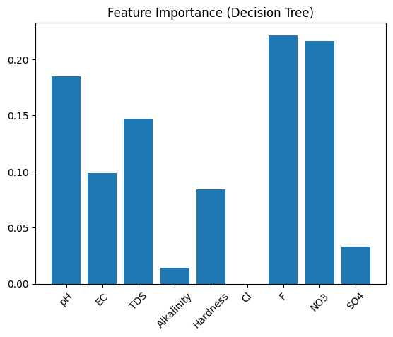

Slide 17
DISCUSSION
Key Insights Derived from the Project
1. accuracy in classifying groundwater quality based on physicochemical parameters.
2.Parameters like TDS, EC, and hardness had strong influence on water quality prediction.
Challenges Faced (Data Quality, Noise, Imbalance, Feature Selection)
1.Presence of missing values and noisy data affected model performance.
2.Class imbalance (more “safe” than “unsafe” samples) required careful handling for accurate prediction.
Limitations of the Approach or Dataset
1.Limited dataset size and region-specific data reduce generalization to other areas.
2.Lack of temporal data (seasonal variations) limits long-term prediction capability.
Impact on Agricultural Decision-Making
1.Helps farmers identify safe groundwater for irrigation, improving crop yield and soil health.
2.Supports efficient water resource management and sustainable farming

Slide 18
CONCLUSION & FUTUREWORK
Project Summary & Outcomes
Random Forest performed best, providing reliable and accurate predictions.
Potential Improvements
Use larger and more diverse datasets (multi-seasonal, multi-location).
Apply advanced models (Deep Learning, Ensemble techniques) and real-time IoT-based monitoring systems.
.
Practical Appliations in Farming
Helps farmers select suitable water for irrigation, preventing soil degradation.
Supports precision agriculture and sustainable water management.
Learning & Acknowledgement
Gained hands-on experience in data preprocessing, model building, and evaluation.
Developed skills in applying AI/ML for real-world agricultural problems.

Slide 19
REFERENCES
DATA SOURCE : Ground water quality 2018 post monsoon data from kaggle
1. Devendra Dohare, Shriram Deshpande, Atul
Kotiya -Research Journal of Engineering
Sciences ISSN 2278, 9472, 2014​
2. Praharsh S Patel, Dishant M Pandya,
Manan Shah(2023)- Environmental
Science and Pollution Research 30 (19),
54303-54323, 2023​
3. Joshua O Ighalo, Adewale George Adeniyi,
Gonçal-Modeling Earth Systems and
Environment 7 (2), 669-681, 2021​1

Slide 20
CoA GKVK
══════════ THANK YOU ! ══════════
MACHIENE LEARNING BASED GROUNDWATER QUALITY ANALYSIS
EAI-421: AI & ML in Agriculture (0+10)
AMRUTHA VARSHINI
K.KAVYA
PROMOD.P

